Slide 1

Reconstructing
“An Interpretable Neuro-symbolic Model for Raven's Progressive Matrices Reasoning”
(Zhao et al., 2023)
1

Slide 2

Motivation
Humans solve Raven’s progressive matrices (RPM) problems in hierarchical manner
(Tolman et al., 1948) introduced cognitive maps first
Humans perceive conceptual features with feature cognitive maps
Tolman, E. C. (1948). Cognitive maps in rats and men. Psychological Review, 55(4), 189–208. https://doi.org/10.1037/h0061626

Slide 3
Motivation
Many models are pattern-based and exploit biases
Can we build a human-like approach that performs good at this tasks?
Can we validate the results of the paper and reproduce them?

Slide 4
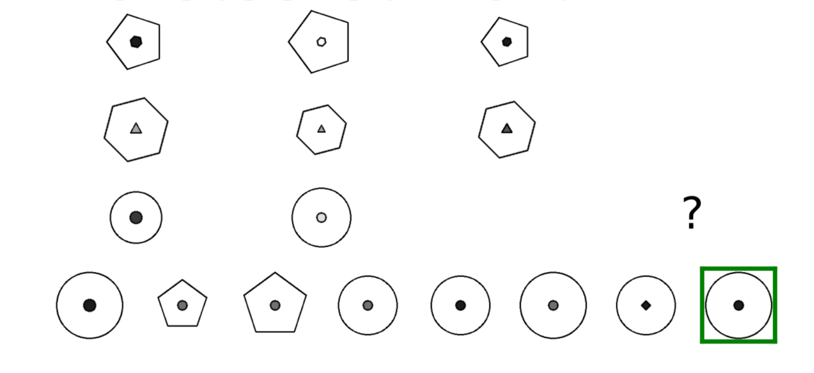
Motivation
?
RAVEN: Zhang, C., Gao, F., Jia, B., Zhu, Y., & Zhu, S. C. (2019). Raven: A dataset for relational and analogical visual reasoning. In Proceedings of the IEEE/CVF conference on computer vision and pattern recognition (pp. 5317-5327).
Notes:
As you have seen in the background of the title slide, the dataset we’re gonna train on is Raven’s progressive matrices, an IQ test widely used in Abstract visual reasoning.
You are given 8 panels with objects and need find a pattern and choose one panel of the bottom ones that fits

Slide 5

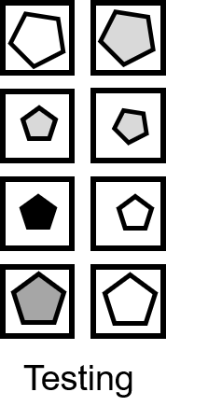




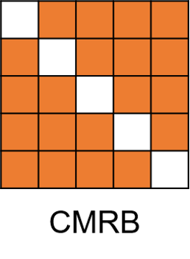


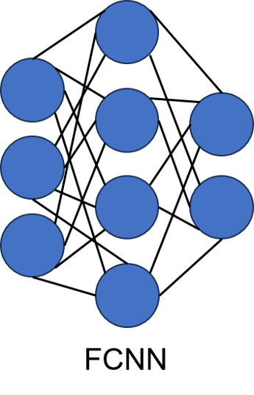
Methods
Abstracted from Zhao, S., You, H., Zhang, R.-Y., Si, B., Zhen, Z., Wan, X., & Wang, D.-H. (2023). An Interpretable Neuro-symbolic Model for Raven’s Progressive Matrices Reasoning. Cognitive Computation, 15(5), 1703–1724. https://doi.org/10.1007/S12559-023-10154-3
Notes:
CMRB: Look at sematic features, predict sematic features of solution panel

Slide 6
Methods - Data
Training on Raven & Raven-F
Center
2x2
3x3
Left-Right
Up-Down
Out-InCenter
Out-InGrid
RAVEN-F: Benny, Y., Pekar, N., & Wolf, L. (2021). Scale-localized abstract reasoning. In Proceedings of the IEEE/CVF conference on computer vision and pattern recognition (pp. 12557-12565).
Dataset Generation with: Langer, J. (2024). RAVEN_FAIR [Source code]. GitHub. https://github.com/johannes-langer/RAVEN_FAIR (Forked from Y. Benny, https://github.com/yanivbenny/RAVEN_FAIR)
Notes:
Used RAVEN and RAVEN-FAIR
dropped I-RAVEN

Slide 7
Methods - FCNN
Supplied with 959 points per class
Recognizes the structural organization of the problem
Extracts object position information
→ Build to categorize dataset into 1 of 7 classes
5 Layers: 16 → 32 → 64 → 128 dimensions and feedforward layer
Confirmed Accuracy: 100%
Zhao, S., You, H., Zhang, R.-Y., Si, B., Zhen, Z., Wan, X., & Wang, D.-H. (2023). An Interpretable Neuro-symbolic Model for Raven’s Progressive Matrices Reasoning. Cognitive Computation, 15(5), 1703–1724. https://doi.org/10.1007/S12559-023-10154-3
Jonathan Long, Evan Shelhamer, Trevor Darrell (2014). Fully Convolutional Networks for Semantic Segmentation.

Slide 8


Methods - sVAE
- extends β-VAE (tries to disentangle features) via supervised bottleneck
One for every Problem class (2x for O-IC , O-IG )
( )
Irina Higgins, Loïc Matthey, Arka Pal, Christopher P. Burgess, Xavier Glorot, Matthew M. Botvinick, Shakir Mohamed, Alexander Lerchner: beta-VAE: Learning Basic Visual Concepts with a Constrained Variational Framework. ICLR (Poster) 2017
Notes:
! was ist ein VAE?
! Why disentanglement?
extends beta VAE (tries to disentangle features) with a supervised bottleneck
Structured with 5 encoder layers and one feature encoder (that was trained supervised on the generators own metadata)
→ We train one of them for every Problem class, two classes split between outer and inner shapes

Slide 9
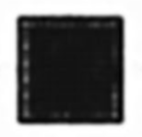
Reconstruction
CMRB output:
Semantic Feature prediction
sVAE reconstruction
Zhao, S., You, H., Zhang, R.-Y., Si, B., Zhen, Z., Wan, X., & Wang, D.-H. (2023). An Interpretable Neuro-symbolic Model for Raven’s Progressive Matrices Reasoning. Cognitive Computation, 15(5), 1703–1724. https://doi.org/10.1007/S12559-023-10154-3

Slide 10
Methods -sVAE
Latent variables are put into a semantic feature layer to make the results understandable
29 dimensions (5 types, 10 colors, 6 sizes, 8 angles)
Trained on 500 problems per configuration
Zhao, S., You, H., Zhang, R.-Y., Si, B., Zhen, Z., Wan, X., & Wang, D.-H. (2023). An Interpretable Neuro-symbolic Model for Raven’s Progressive Matrices Reasoning. Cognitive Computation, 15(5), 1703–1724. https://doi.org/10.1007/S12559-023-10154-3
Notes:
Latent variables are put into a semantic feature layer to make the results understandable
29 dimensions (5 types, 10 colors, 6 sizes, 8 angles)
Trained with only 500 problems per configuration
Achieved 100% Accuracy

Slide 11
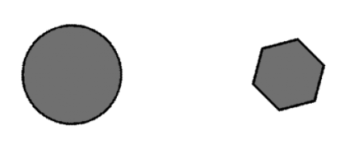
Cognitive Maps
Psychology: Humans use cognitive maps (CMs) to infer features of spatial objects
  Relationships between different spacial objects
In ML: Comparing semantic features
>
size
Notes:
Originates in Psychology: Models relationship between different (spacial) objects
We use it to compare semantic features of panels in RPM problems

Slide 12
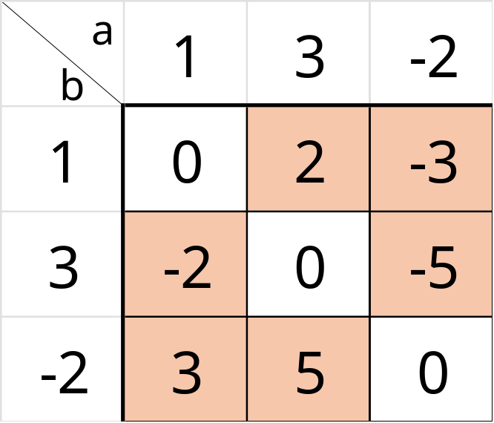

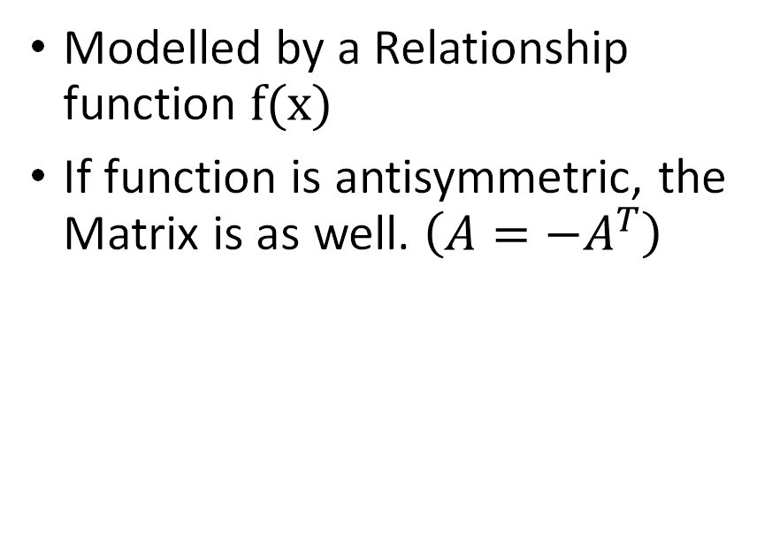
CM – Technical Perspective
$$f\left(x\right)=a−b$$
Relationship matrix
Modelled by a Relationship function $f(x)$
If function is antisymmetric, the Matrix is as well. $\left(A=−A^{T}\right)$
Notes:
In the CMRB:
Modelled by a matrix and a relationship function
If the function is antisymmetric, the matrix is as well → optimisation possible

Slide 13
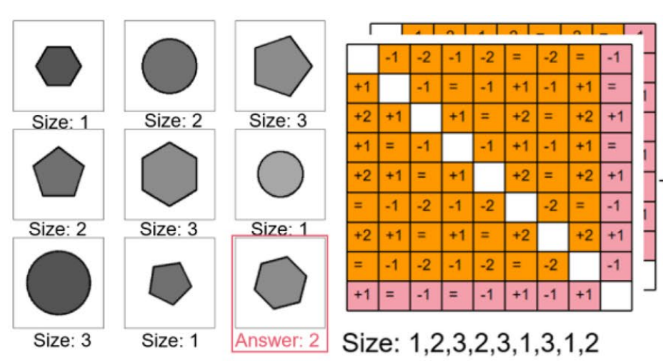
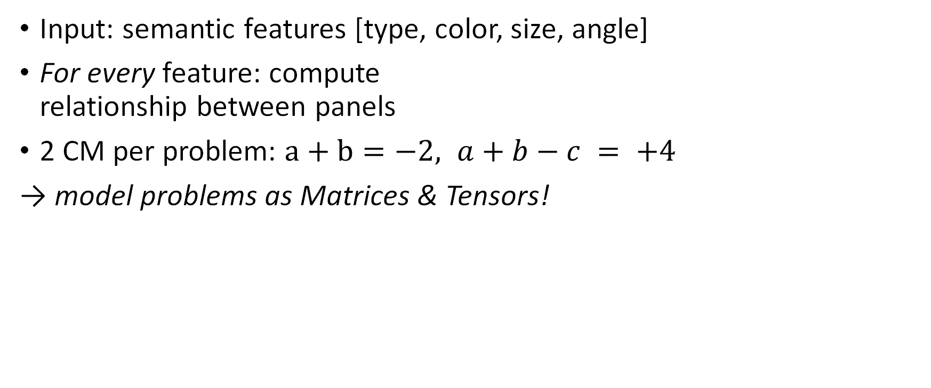
CMRB
Input: semantic features [type, color, size, angle]
For every feature: compute
relationship between panels
2 CM per problem: $a+b=−2, a+b−c = +4$
→ model problems as Matrices & Tensors!
Zhao, S., You, H., Zhang, R.-Y., Si, B., Zhen, Z., Wan, X., & Wang, D.-H. (2023). An Interpretable Neuro-symbolic Model for Raven’s Progressive Matrices Reasoning. Cognitive Computation, 15(5), 1703–1724. https://doi.org/10.1007/S12559-023-10154-3
Notes:
Many CMs form a CMRB.
We take in the semantic features of all panels •[type, color, size, angle]
and predict semantic features of solution panel.
2 Cases:
Pairwise relationship: CMRB is 9x9 Matrix
Three-way relationship: CMRB is 9x9x9 tensor (this is likely done, because in RPM rows and columns form patterns)
Note that the formulas can vary.
On highlevel: we model Problems as Matrices and Tensors

Slide 14
CMRB
Zhao, S., You, H., Zhang, R.-Y., Si, B., Zhen, Z., Wan, X., & Wang, D.-H. (2023). An Interpretable Neuro-symbolic Model for Raven’s Progressive Matrices Reasoning. Cognitive Computation, 15(5), 1703–1724. https://doi.org/10.1007/S12559-023-10154-3
Notes:
Many CMs form a CMRB.
We take in the semantic features of all panels •[type, color, size, angle]
and predict semantic features of solution panel.
2 Cases:
Pairwise relationship: CMRB is 9x9 Matrix
Three-way relationship: CMRB is 9x9x9 tensor (this is likely done, because in RPM rows and columns form patterns)
Note that the formulas can vary.
On highlevel: we model Problems as Matrices and Tensors

Slide 15
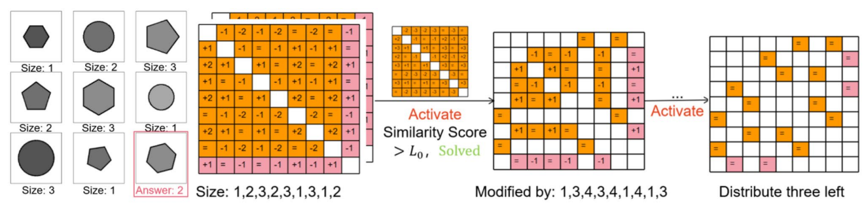
Methods – Training Algorithm
For every Problem: Compare with 30 old matrices:
If (similar and intersection can solve old + new problem)
  Trim & update old map
If there is no map fits:
  Save in LTM (overwrite least used CM if necessary)
Zhao, S., You, H., Zhang, R.-Y., Si, B., Zhen, Z., Wan, X., & Wang, D.-H. (2023). An Interpretable Neuro-symbolic Model for Raven’s Progressive Matrices Reasoning. Cognitive Computation, 15(5), 1703–1724. https://doi.org/10.1007/S12559-023-10154-3
Notes:
The CMRB also introduces a novel training algorithm
We loop over all problems and compare them with all other matrices in the Long term memory (Zhao uses 30)
we combine them and solve both the previous problem of the old matrix and the new one.
If they solve both Problems and are sufficiently similar: Save them in the Long term memory and overwrite a matrix with the least uses if necessary

Slide 16
CMRB: Memory Dimensions
& demonstrating how Data Requirements blow up

Slide 17
Cognitive Map
9 Panels
a b | 1 | 3 | -2 | 4 | 0 | 1 | -1 | -4 | 2
1 | 0 | 2 | -3 | 3 | -1 | 0 | -2 | -5 | 1
3 | -2 | 0 | -5 | 1 | -3 | -2 | -4 | -7 | -1
-2 | 3 | 5 | 0 | 6 | 2 | 3 | 1 | -2 | 4
4 | -3 | -1 | -6 | 0 | -4 | -3 | -5 | -8 | -2
0 | 1 | 3 | -2 | 4 | 0 | 1 | -1 | -4 | 2
1 | 0 | 2 | -3 | 3 | -1 | 0 | -2 | -5 | 1
-1 | 2 | 4 | -1 | 5 | 1 | 2 | 0 | -3 | 3
-4 | 5 | 7 | 2 | 8 | 4 | 5 | 3 | 0 | 6
2 | -1 | 1 | -4 | 2 | -2 | -1 | -3 | -6 | 0
9 Panels
Notes:
Let's talk about memory!
One simple CM is a 9 x 9 matrix of attribute values
We represent an attribute by both a pairwise matrix and a 3-way relationship tensor
For 1 panel, we need 4 features
In our model, we store at most 30 of these feature maps
We train a separate model for every problem type

Slide 18
One Attribute
9x9x9
9x9
+
9 Panels
Notes:
Let's talk about memory!
One simple CM is a 9 x 9 matrix of attribute values
We represent an attribute by both a pairwise matrix and a 3-way relationship tensor
For 1 panel, we need 4 features
In our model, we store at most 30 of these feature maps
We train a separate model for every problem type

Slide 19
One RPM Problem
9x9x9
9x9
+
5 * Type
10 * Colour
6 * Size
8 * Angle
9x9x9
9x9
+
9x9x9
9x9
+
9x9x9
9x9
+
Notes:
Let's talk about memory!
One simple CM is a 9 x 9 matrix of attribute values
We represent an attribute by both a pairwise matrix and a 3-way relationship tensor
For 1 panel, we need 4 features
In our model, we store at most 30 of these feature maps
We train a separate model for every problem type

Slide 20
One Model: 30 CMs
LTM
Lt
9x9x9
9x9
9x9x9
9x9
9x9x9
9x9
9x9x9
9x9
+
x30
9x9x9
9x9
9x9x9
9x9
9x9x9
9x9
9x9x9
9x9
+
Notes:
Let's talk about memory!
One simple CM is a 9 x 9 matrix of attribute values
We represent an attribute by both a pairwise matrix and a 3-way relationship tensor
For 1 panel, we need 4 features
In our model, we store at most 30 of these feature maps
We train a separate model for every problem type

Slide 21
Full CMRB
Model 1
Model 2
Model 3
Model 4
Model 5
Model 6
Model 7
Model 8
Model 9
Notes:
Let's talk about memory!
One simple CM is a 9 x 9 matrix of attribute values
We represent an attribute by both a pairwise matrix and a 3-way relationship tensor
For 1 panel, we need 4 features
In our model, we store at most 30 of these feature maps
We train a separate model for every problem type

Slide 22
Limitations
Needs sematic features (in paper: FCNN -> sVAE pipeline)
Only 3-way connections found: ↗️ False positives
Not a probabilistic approach, no uncertainty
(probably) not robust

Slide 23
RPM-Tailored Design
connections between limited number of objects
Raven: choose one pattern and permute by it -> Building pattern tree
Purely nominal relationships
Hand-designed Ruleset: Specifically for Raven

Slide 24
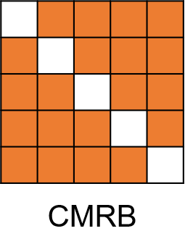
Methods - Testing
Predict solution
Compare with
Zhao, S., You, H., Zhang, R.-Y., Si, B., Zhen, Z., Wan, X., & Wang, D.-H. (2023). An Interpretable Neuro-symbolic Model for Raven’s Progressive Matrices Reasoning. Cognitive Computation, 15(5), 1703–1724. https://doi.org/10.1007/S12559-023-10154-3

Slide 25
Evaluation
Training details:
Hardware: Hydra & Chimaira
Specific hyperparameters per model in appendix
Experiments:
Compared Raven-F & Raven
Accuracy tests for all classes
Statistical t-Test (confidence intervals)
3 folds
15000 samples
Component | Epochs
FCNN | 50
sVAE | 10
Zhao, S., You, H., Zhang, R.-Y., Si, B., Zhen, Z., Wan, X., & Wang, D.-H. (2023). An Interpretable Neuro-symbolic Model for Raven’s Progressive Matrices Reasoning. Cognitive Computation, 15(5), 1703–1724. https://doi.org/10.1007/S12559-023-10154-3

Slide 26
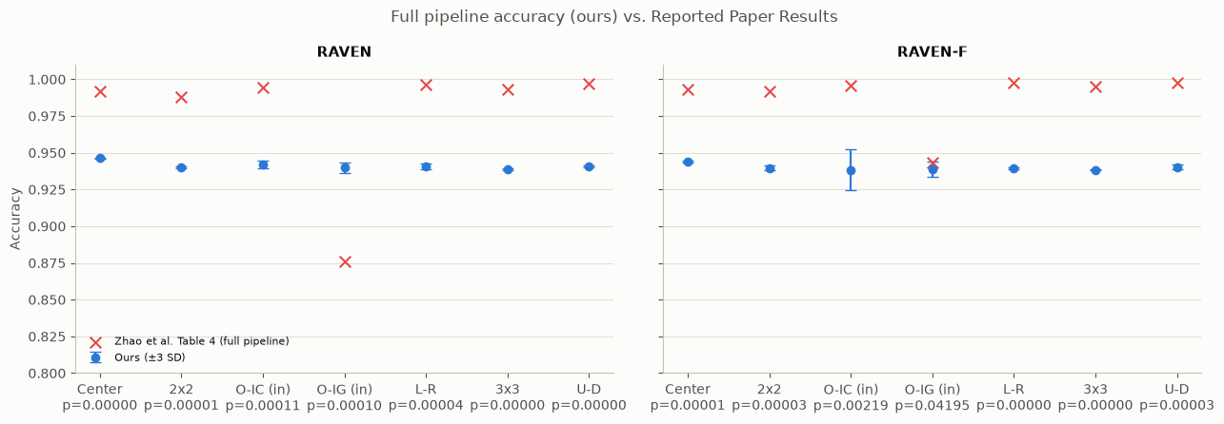
Evaluation
Continuously (strongly) significant deviation from paper results: $∀p_{i}:p_{i}<0,05$
O-IG (in) outlier
Zhao, S., You, H., Zhang, R.-Y., Si, B., Zhen, Z., Wan, X., & Wang, D.-H. (2023). An Interpretable Neuro-symbolic Model for Raven’s Progressive Matrices Reasoning. Cognitive Computation, 15(5), 1703–1724. https://doi.org/10.1007/S12559-023-10154-3

Slide 27
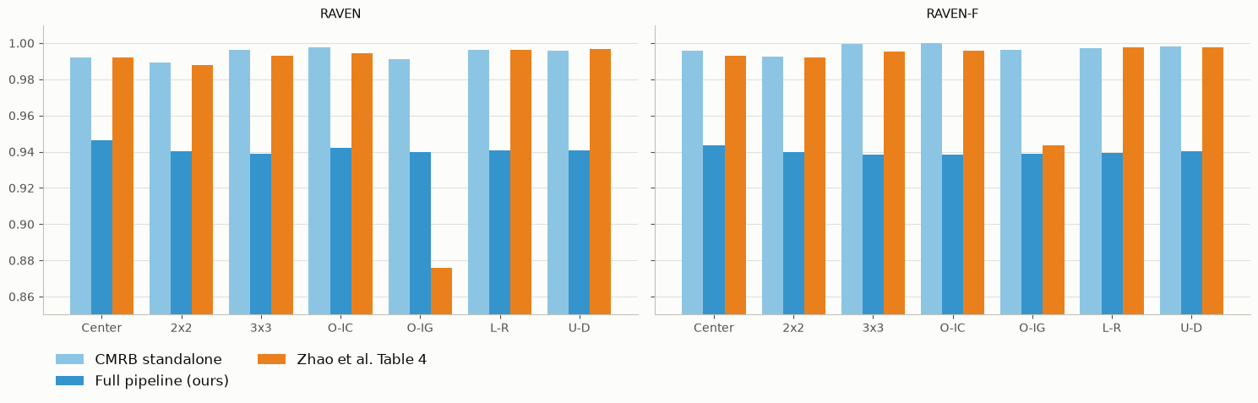
Standalone & Full Evaluation
Notes:
Ground truth durch Dataset generation

Slide 28
Evaluation
Our tests:
Statistical significant deviation of the results
Still great results
Comparison:
Zhao, S., You, H., Zhang, R.-Y., Si, B., Zhen, Z., Wan, X., & Wang, D.-H. (2023). An Interpretable Neuro-symbolic Model for Raven’s Progressive Matrices Reasoning. Cognitive Computation, 15(5), 1703–1724. https://doi.org/10.1007/S12559-023-10154-3

Slide 29
Discussion
Limitations:
Hardly documented training process
  Frequent assumptions neccessary
  Time restrictions
Not many folds (lack of hardware)- (Training time of CMRB, sVAE increases drastically)
  Big Kfold not feasable at scale
  Goal until August: Run a bigger kFold, try other configs

Slide 30
Assumptions
The papers 2/3 training split equal to Kfold-test
Sample sizes reasonably chosen by paper
All FCNN / sVAE model parameters (see appendix)
  More than 30 different configs in repository!
Normal accuracy distribution (t-test)
Notes:
We have 959 data points in FCNN, we assume that this is the optimum, we didn’t try other sizes

Slide 31
Conclusion
NOT able to (fully) reconstruct the results from paper
  Doesn’t mean it’s invalid
  CMRB results suspicious
nevertheless: very good CMRB results
  Does not mean it’s a viable approach for ML in general
  Clearly designed around the RPM: unclear generalization on other problems

Slide 32
Appendix: (assumed) Model parameters
sVAE
in_channels: | 1
latent_dim: | 8
gamma: | 20
max_capacity: | 25
Capacity_max_iter: | 10000
train_batch_size: | 32
val_batch_size: | 32
num_workers: | 5
LR: | 0.005
weight_decay: | 0
scheduler_gamma: | 0.95
kld_weight: | 0.00025
manual_seed: | 1265
gpus: | 2
max_epochs: | 1
in_channels: | 1265
FCNN
Num epochs | 50
Batch size | 512
Learning rate | 0.0001

Slide 33
LTM
Lt
9x9
9x9x9
9x9
9x9x9
9x9
9x9x9
9x9
9x9x9
+
x30
9x9
9x9x9
9x9
9x9x9
9x9
9x9x9
9x9
9x9x9
+

Slide 34
The CMRB formulas
Pairwise_map (b, a) = 1 + Δ if 0 ≤ Δ ≤ 9
= 10 + |Δ| if -9 ≤ Δ ≤ -1
= 0 otherwise
Threewise_map (a, b, c) = 20 if a + b = c
= 21 if a − b = c
= 22 if a + b + 1 = c
= 23 if a − b − 1 = c
= 24 if a + b + 2 = c
= 25 if a − b − 2 = c
= 0 otherwise

Slide 35
Related Work
(Zhang et al., 2021):
Neuro visual frontend: Extracts with CNN the features size, position, type and color
Symbolic logical reasoning backend: Collects the probabilistic representation from 8 context panels
Abduces the hidden rules on each attribute
Chi Zhang, Baoxiong Jia, Song-Chun Zhu, Yixin Zhu (2021). Abstract Spatial-Temporal Reasoning via Probabilistic Abduction and Execution. CoRR abs/2103.14230

